Slide 1
Coding seminar
14/07/2023
Lesson 2: Divide and conquer: read, calculate, plot, save
Ikue Hirata, PhD
ikue.hirata@iit.it

Slide 2



Contents
Use packages
Read existing csv file
Calculate a bit
Visualize the result

Slide 3
References for this lesson
Numpy official documentation
Matplotlib official document
Pandas official document
Seaborn official document “Getting started” “Quick start” “Examples” are always there for you
Other online references
O’Reilly books
Google
Ask ChatGPT

Slide 4

What is a package?
Set of functions for specific purpose
Statistical analysis
Plotting
Signal process
Managed by package manager (Anaconda/pip) – Lesson 1

Slide 5




Packages we use today
Sine, cosine, power, logarithm, vector, matrix…
All the basics of plotting
Handling statistic data of various types
Beautiful visualization of statistics

Slide 6
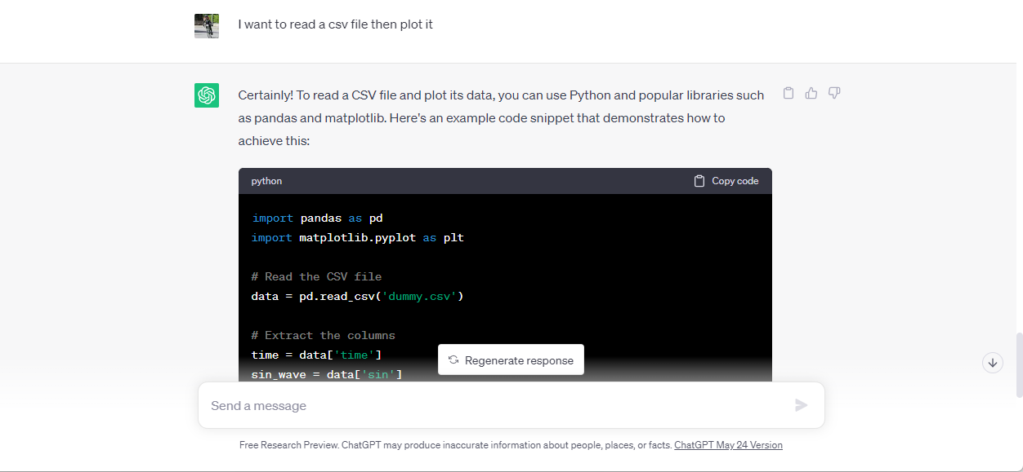
Ask ChatGPT
Prompt engineering

Slide 7
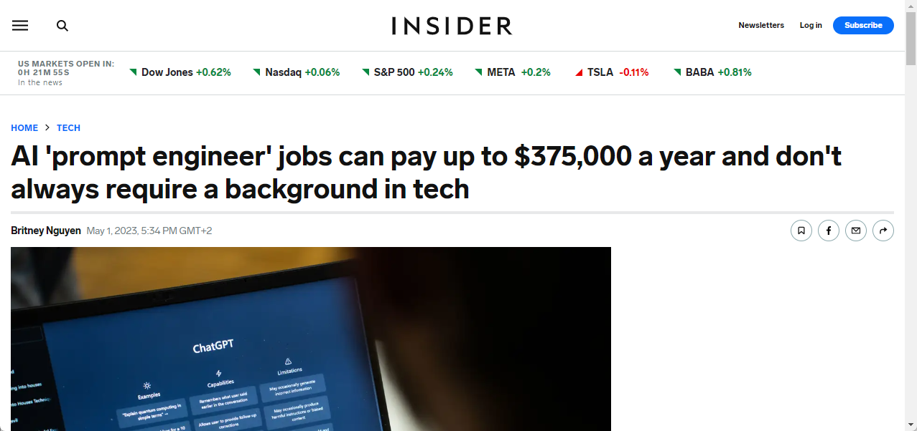
Prompt engineering
!!!!
https://www.businessinsider.com/ai-prompt-engineer-jobs-pay-salary-requirements-no-tech-background-2023-3?r=US&IR=T

Slide 8
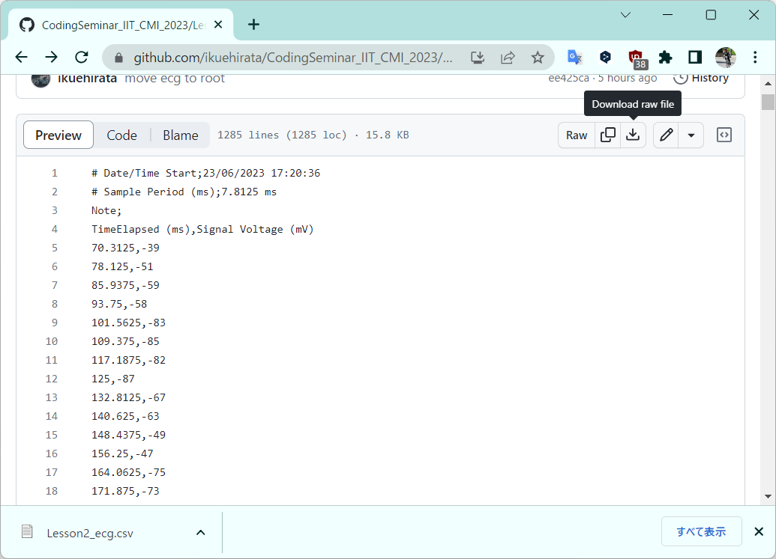
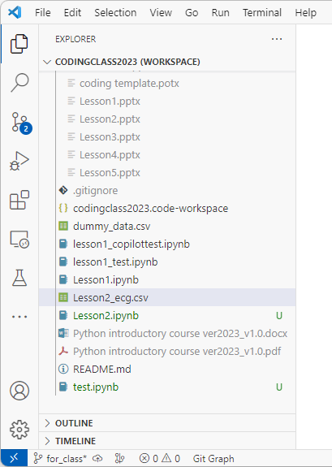
Download demo csv file
Click
Drag & drop

Slide 9
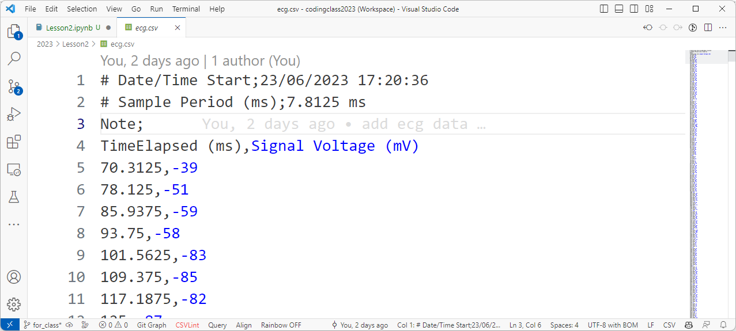
Check csv file
First 4 lines: not needed
Actual data
Split by “,”

Slide 10
Read csv file – (popular) 3 ways
Package | Function | Return object | Non-numerical data | Read headers
numpy | genfromtxt | np.ndarray | no | no
numpy | loadtxt | np.ndarray | yes | no
pandas | read_csv | pandas.DataFrame | yes | no

Slide 11
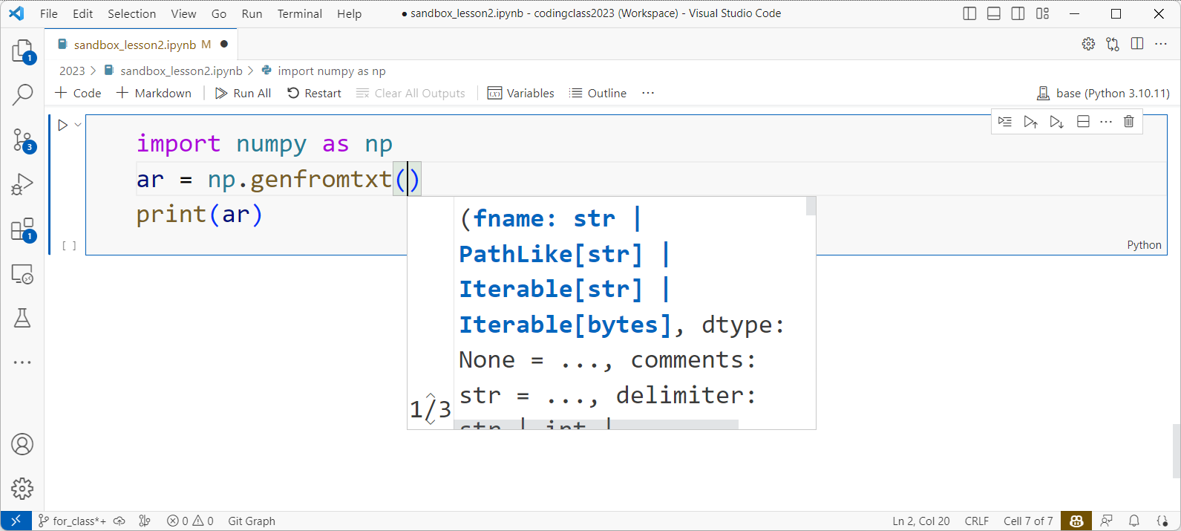
Read csv file 1/3 – genfromtxt
Alias for shortcut
docstring

Slide 12
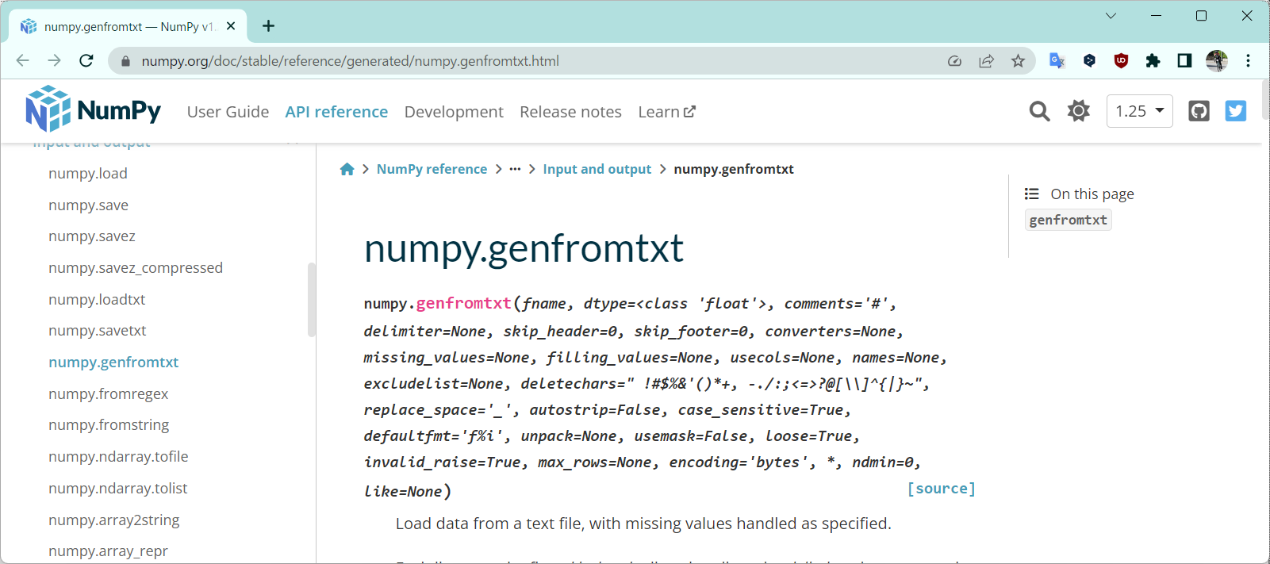
Docstring on manual

Slide 13
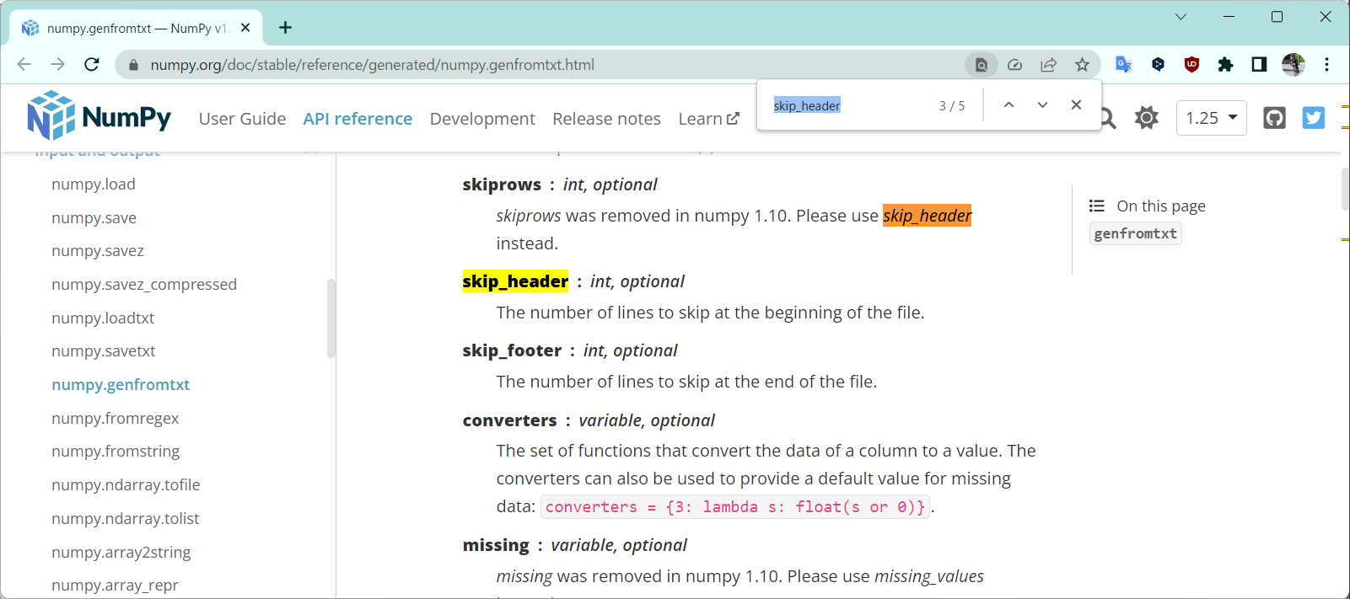
Check meaning of the parameters
[Ctrl] + F

Slide 14
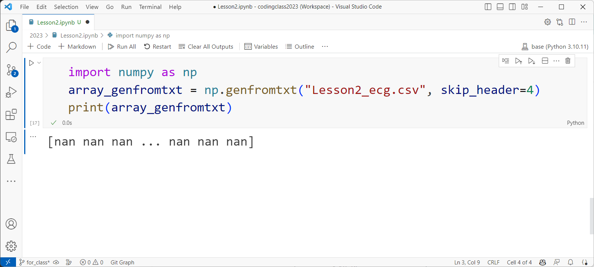
Try with it!

Slide 15
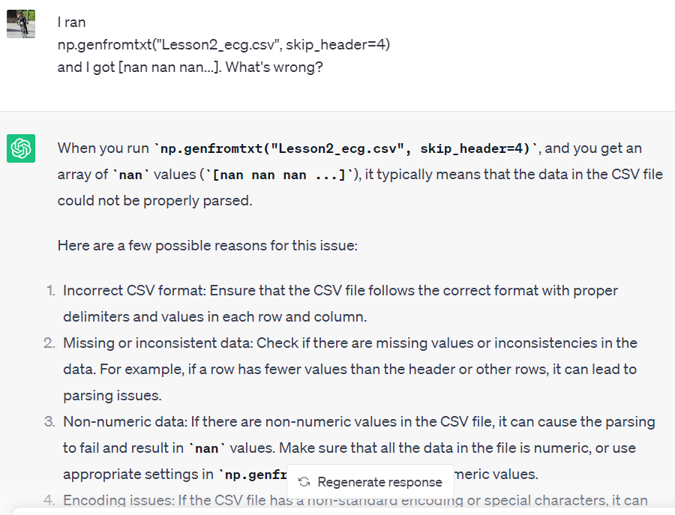
Ask again
[Shift] + [Enter] to add linebreak
?
No
No
?

Slide 16
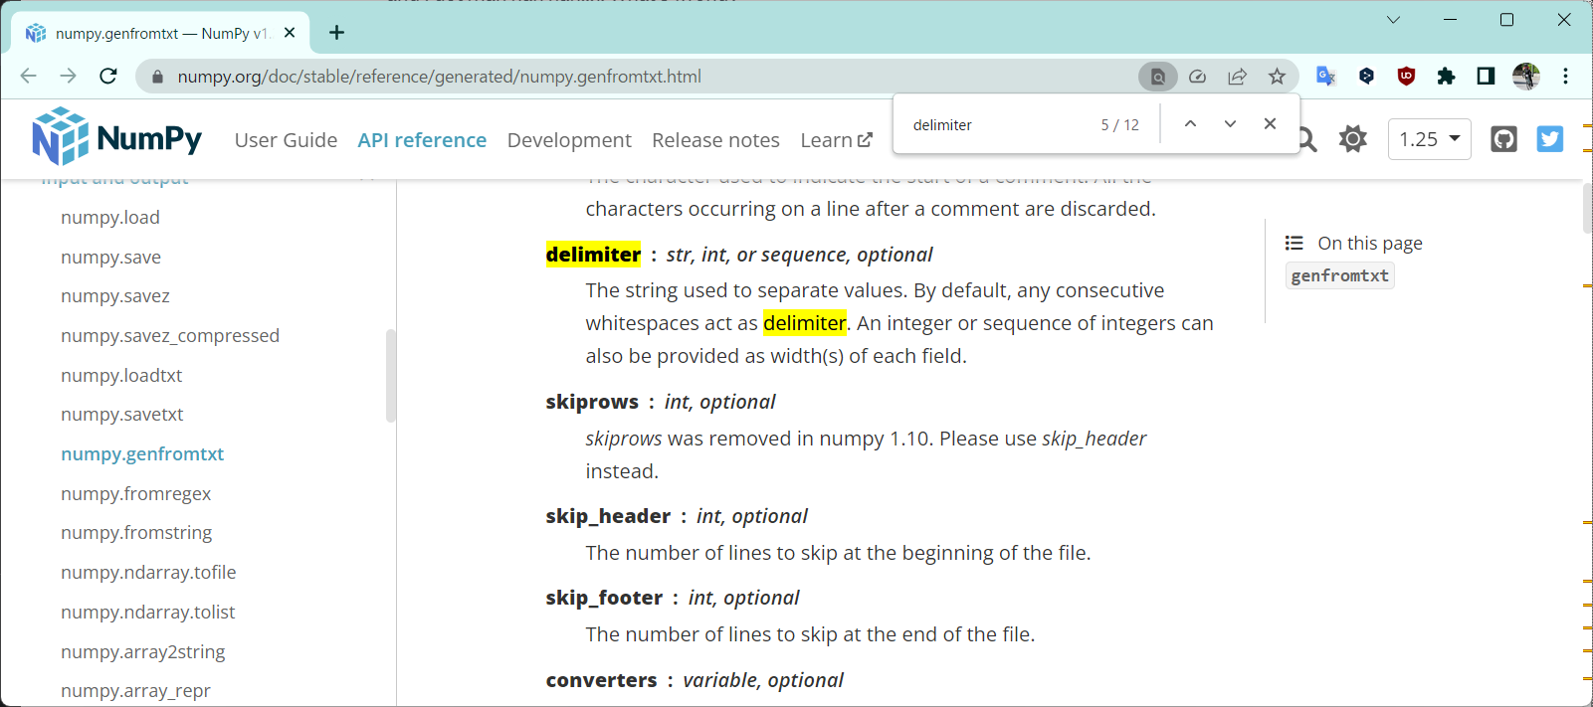
Manual again

Slide 17
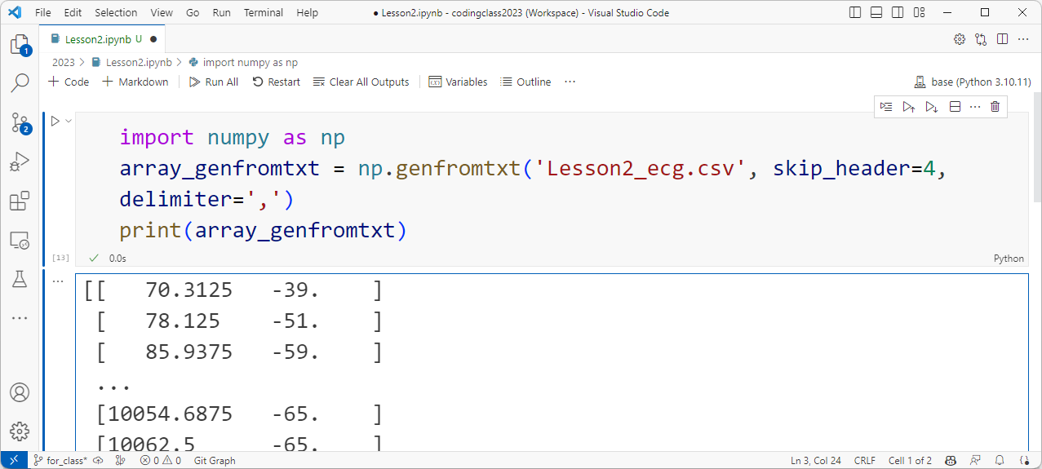
Read csv file 1/3 – genfromtxt
Fast
Most simple when you know it’s numerical only

Slide 18
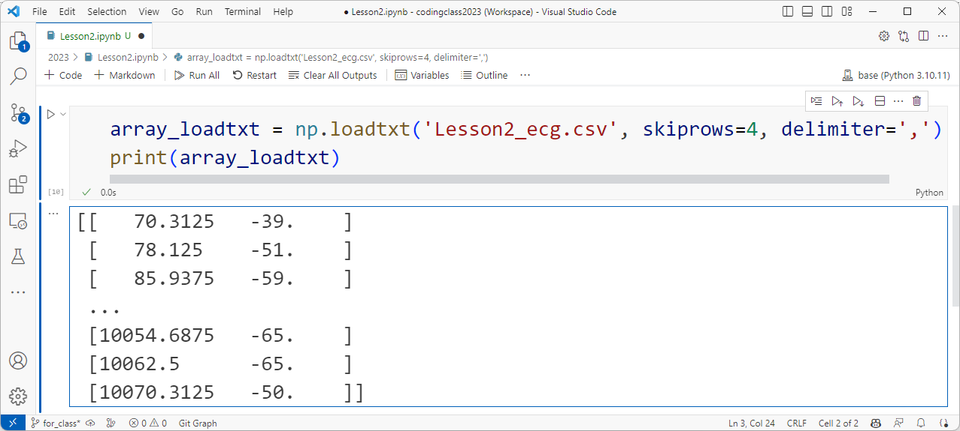
Read csv file 2/3 – loadtxt
Fast
Maybe needs cleaning

Slide 19
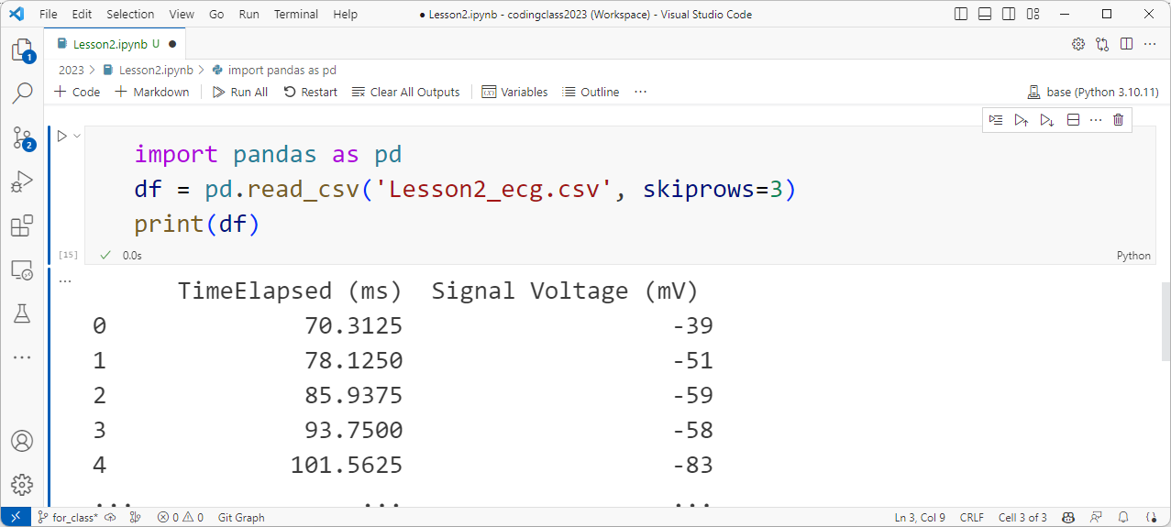
Read csv file 3/3 – read_csv
Slow
Intuitive
Various data types

Slide 20
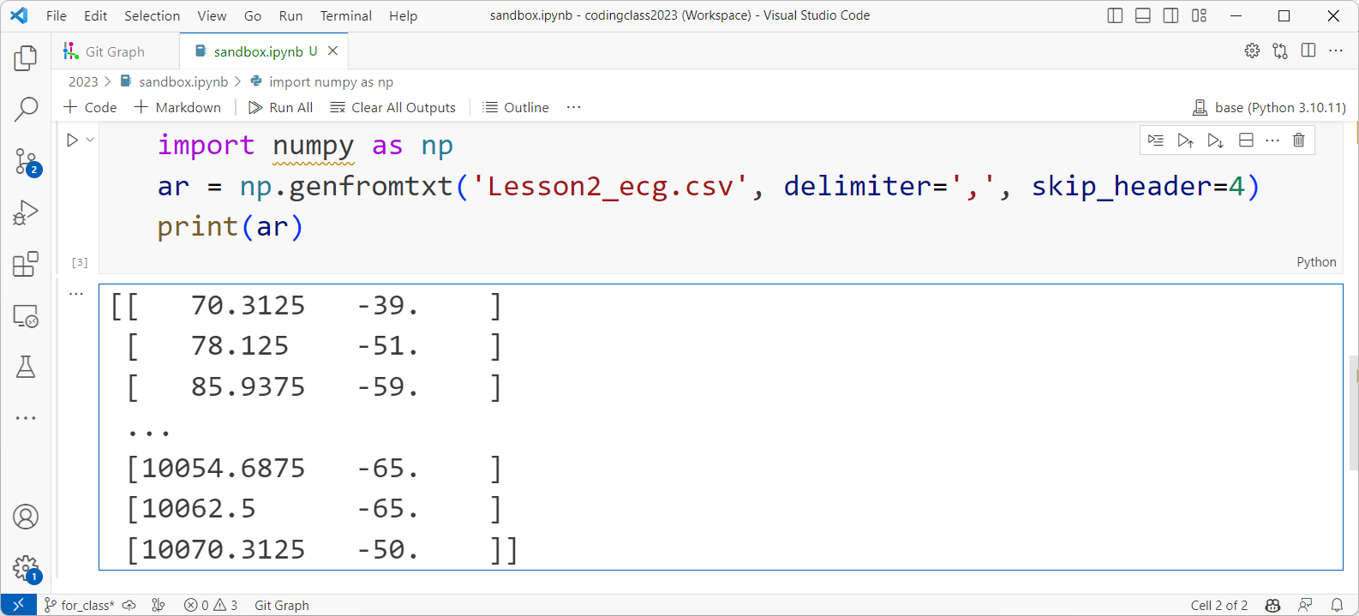
numpy.ndrray indexing
axis 1
axis 0

Slide 21
numpy.ndrray indexing
ar[0]
ar[0, 0]
[0, 1]
ar[1]
ar[1, 0]
[1, 1]
ar[2]
ar[2, 0]
[2, 1]
ar[:, 0]
ar[:, 1]
ar[0, :]
ar[1, :]
ar[2, :]
Search keyword: slicing

Slide 22
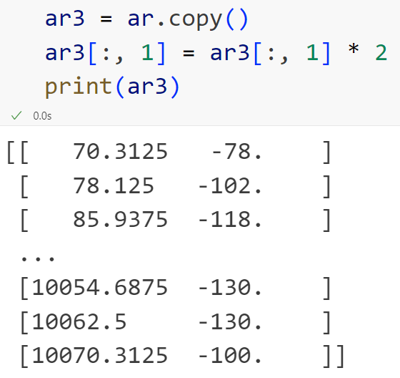
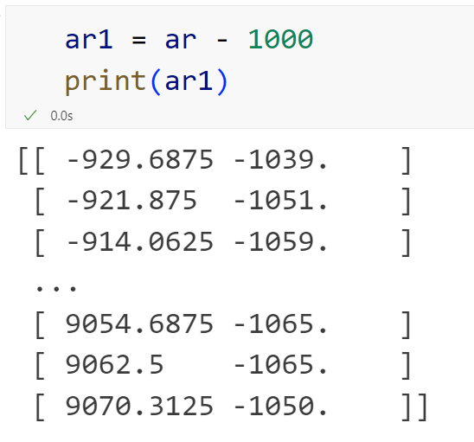
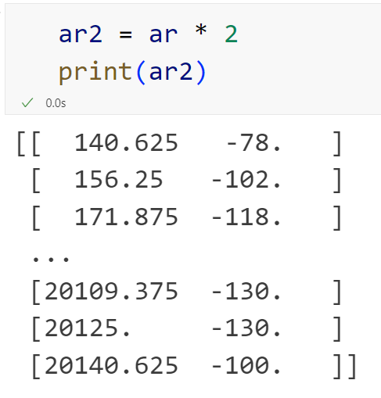
Calculation
Search keyword: call by value, call by reference

Slide 23
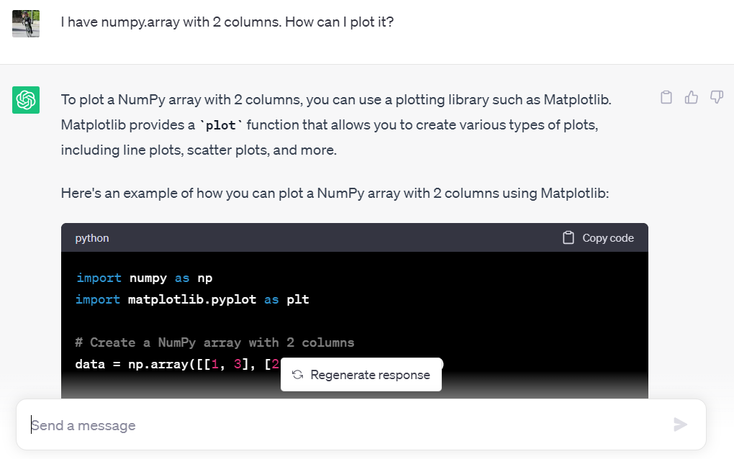
Plot: ask

Slide 24
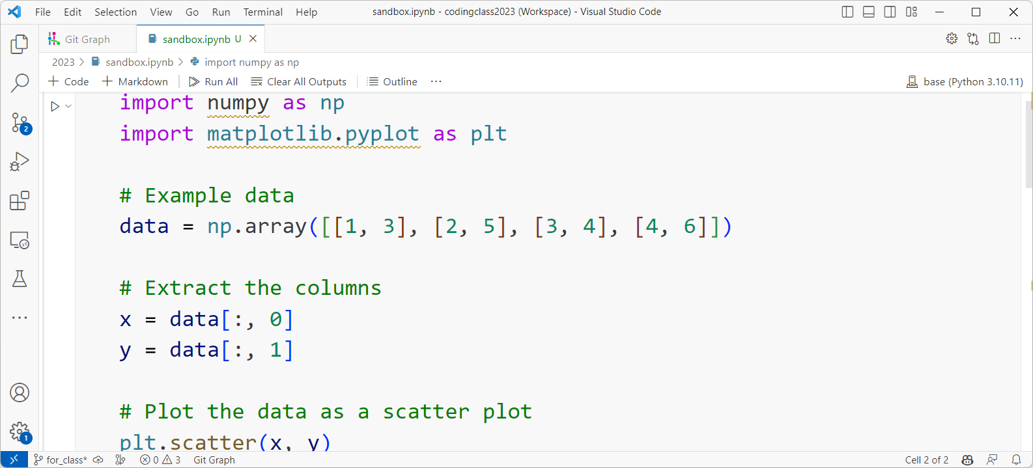
Read and arrange the code
Importing a package for plotting
Generating an array but we already have
Already explained!
This is plot part

Slide 25
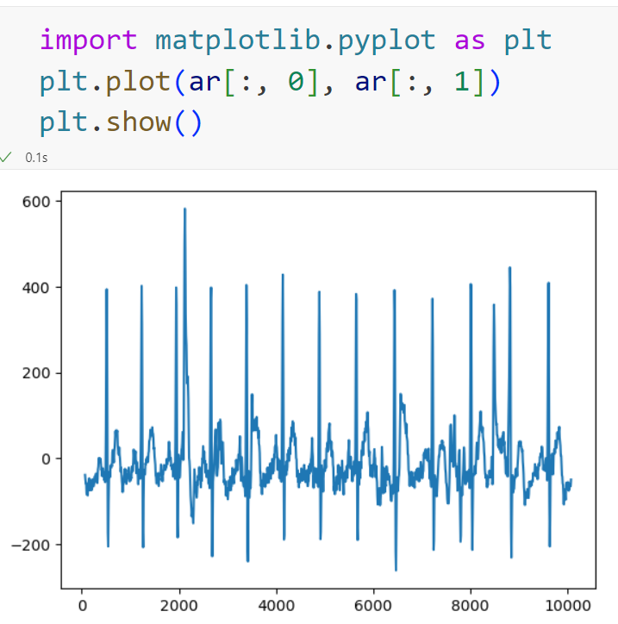
Basic plot
Make line thinner
Y label
Don’t want this gap
X label

Slide 26
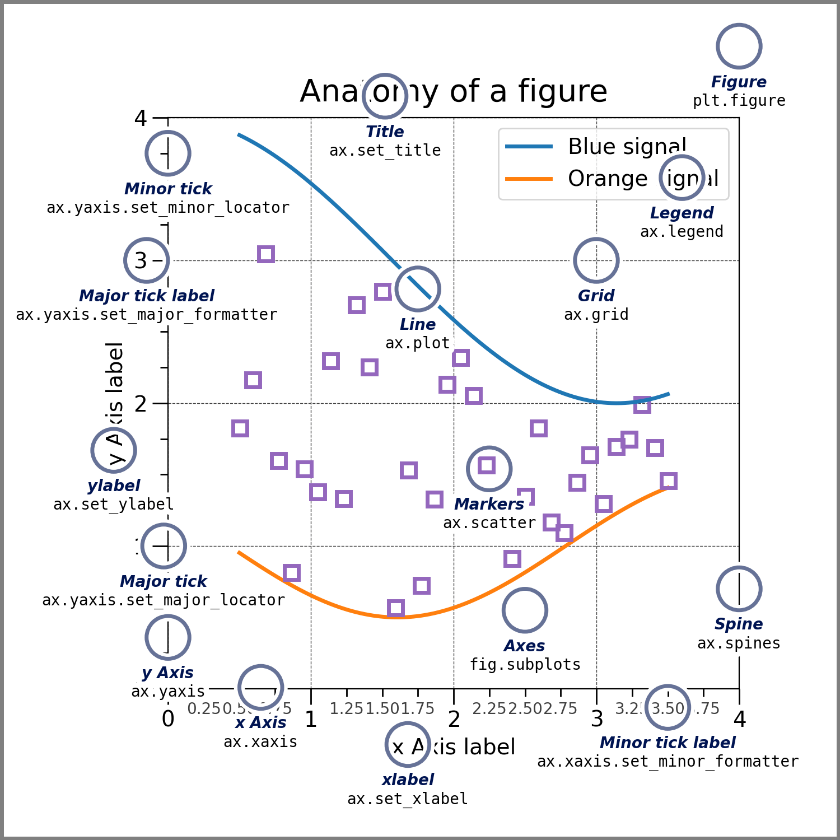
Beautify your graph
https://matplotlib.org/stable/tutorials/introductory/quick_start.html

Slide 27
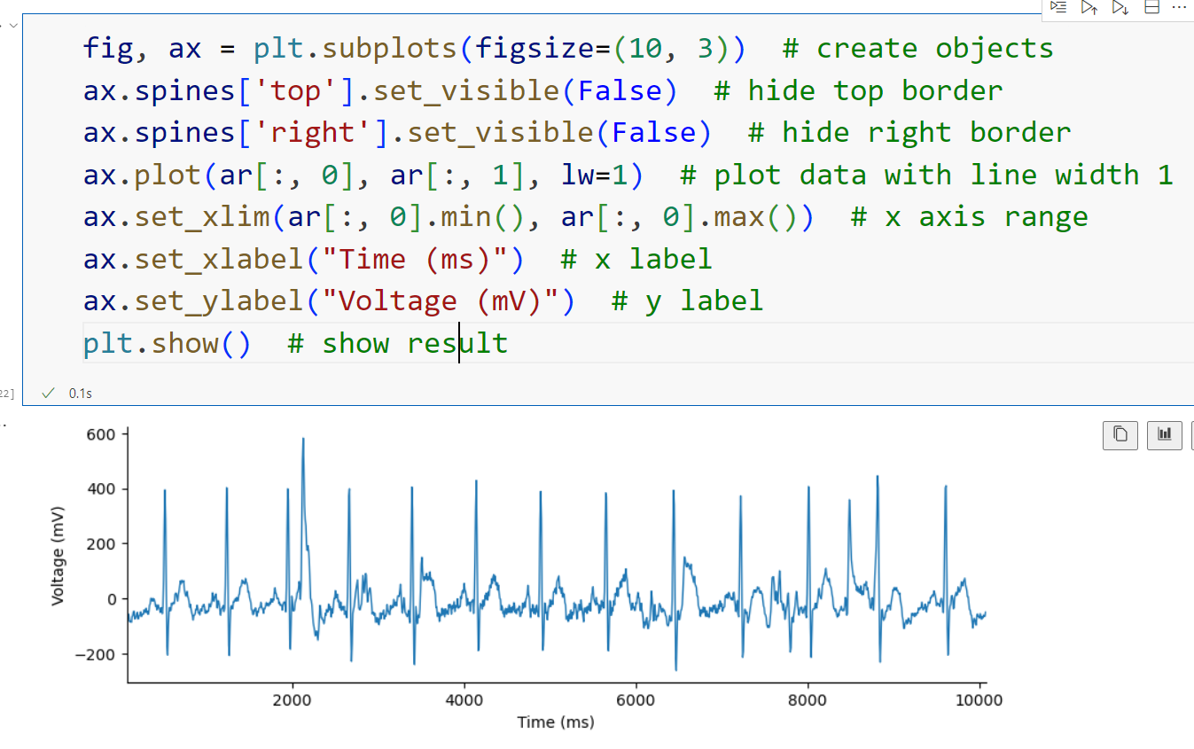
Nature-like plot template

Slide 28
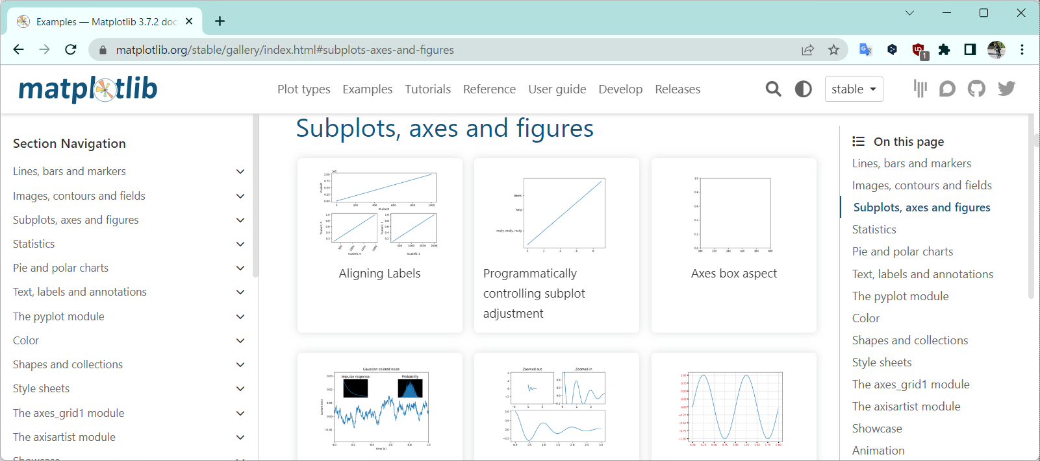
Search from examples

Slide 29
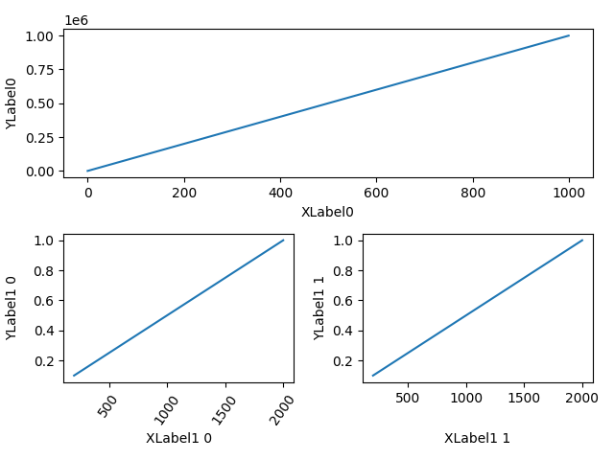
Read the manual: Gridspec

Slide 30
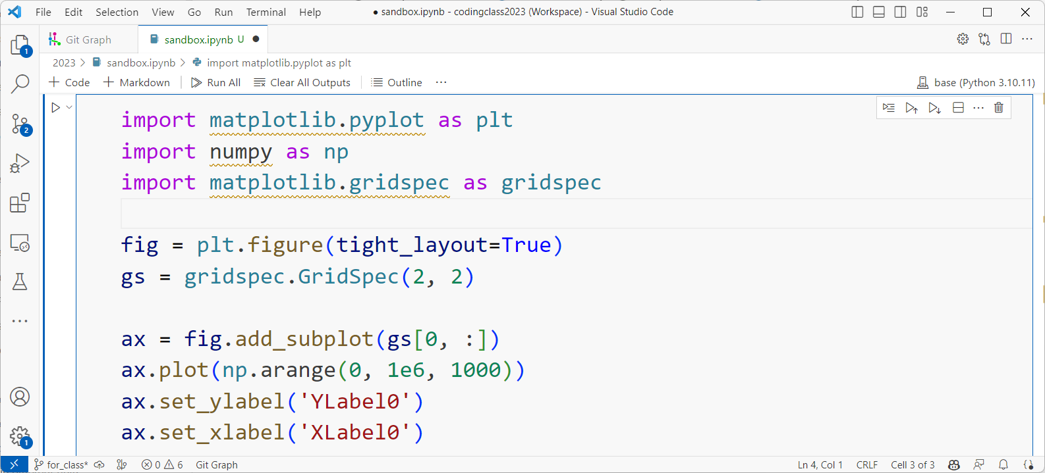
Read the manual: Gridspec
Something new
This is explained in “Getting Started”
Doing something with 2x2
https://matplotlib.org/stable/gallery/subplots_axes_and_figures/align_labels_demo.html#sphx-glr-gallery-subplots-axes-and-figures-align-labels-demo-py

Slide 31
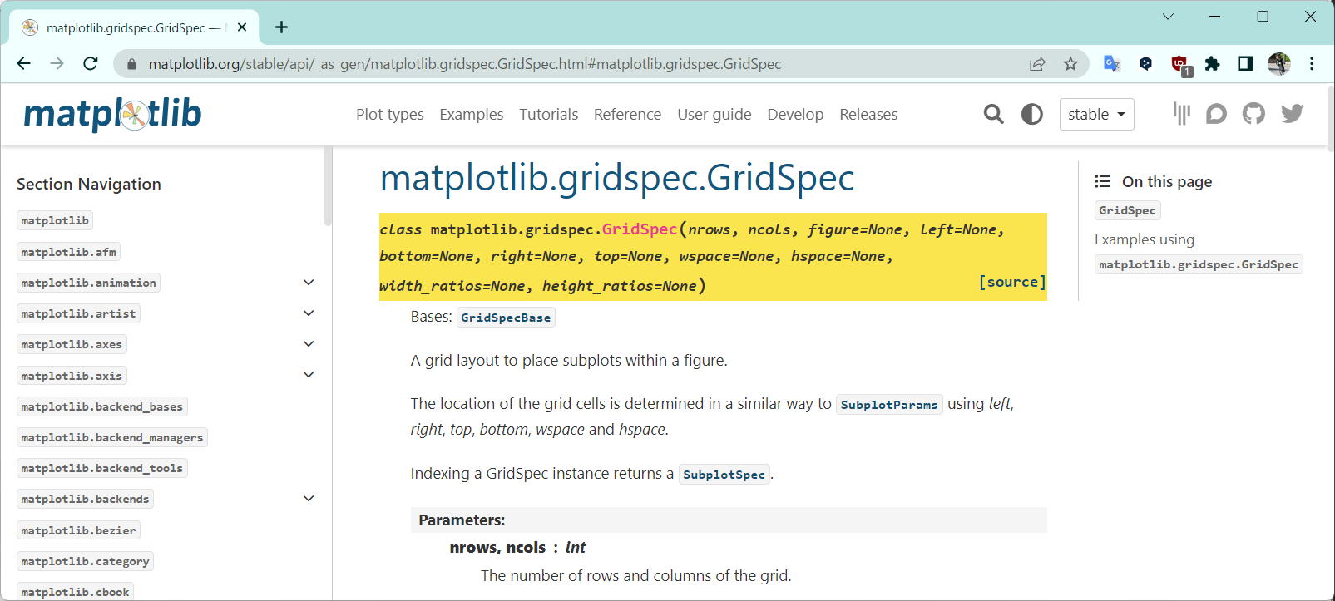
Read the manual: Gridspec

Slide 32
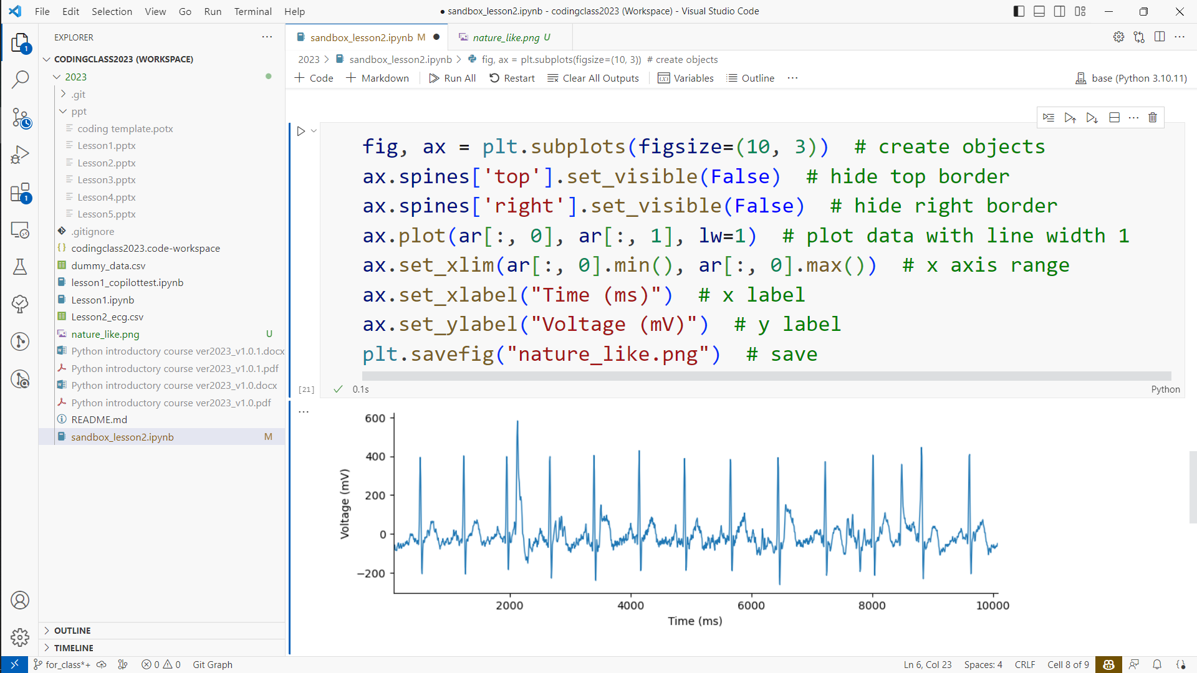
Save image
Format, dpi, etc…

Slide 33
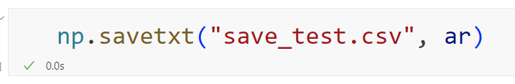
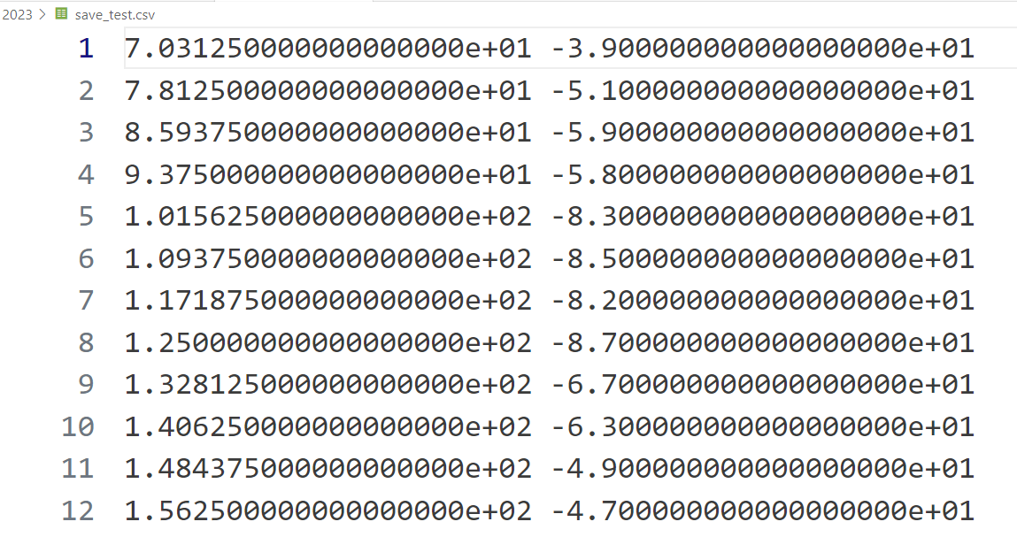
Save csv
Format is changed: set with np.savetxt parameters

Slide 34



Other plotting libraries
Various visualization options
Beautiful default color palettes
Frequently used in machine learning
Highly interactive panels
Implementation to html using dash
Heavier than matplotlib/seaborn
I’m totally new to this but looks great to explore
...and more! Try and find ones that suit your need

Slide 35
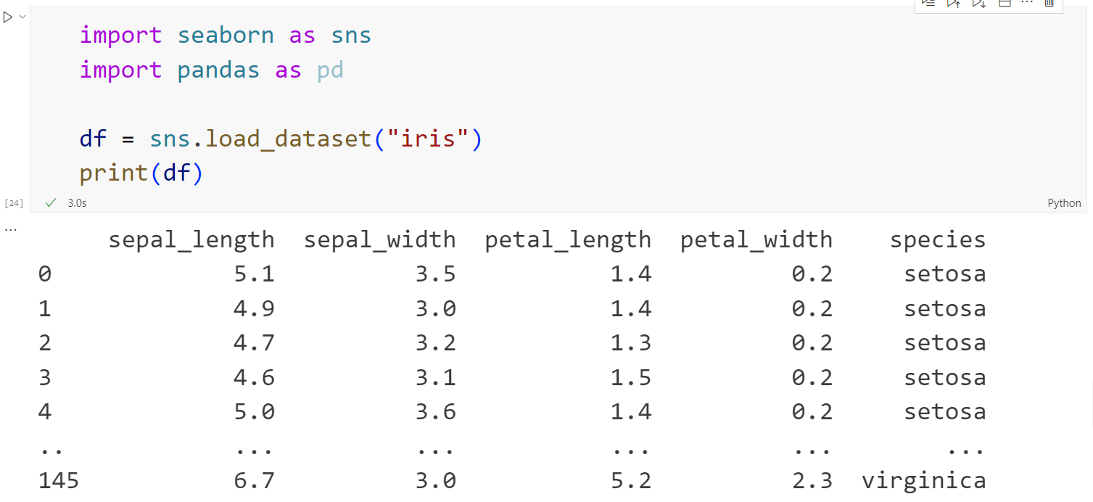
Table containing non-numerical data
Loads “iris” dataset and converts to pandas.DataFrame object

Slide 36
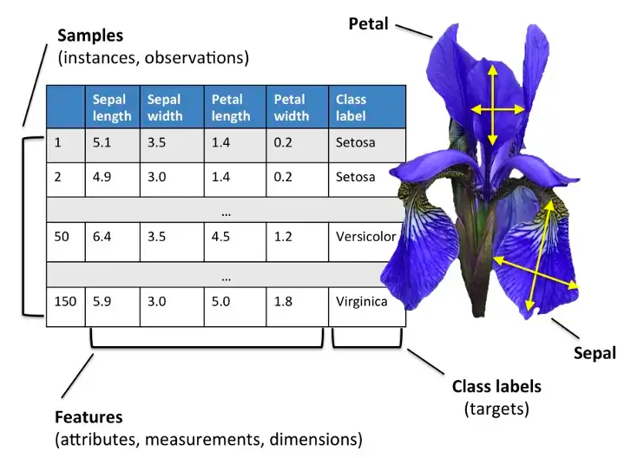
Iris classification
https://eminebozkus.medium.com/exploring-the-iris-flower-dataset-4e000bcc266c

Slide 37
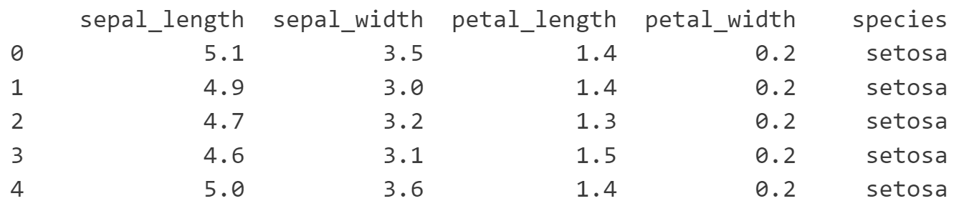
pandas.DataFrame indexing
Columns
df[“sepal_length”]
df[“sepal_width”]
df.index
Rows
df[4, “petal_length”]
Easy to filter by conditions such as df[“sepal_length”] > 5
Lots of statistical functions for analysis
For details, see Getting Started

Slide 38
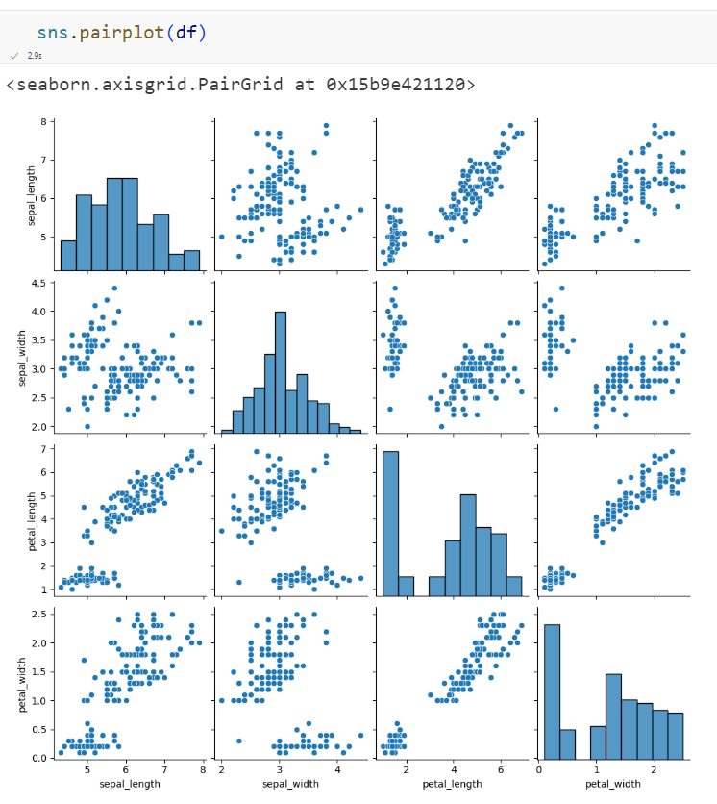
sns.pairplot
All columns with numerical data

Slide 39
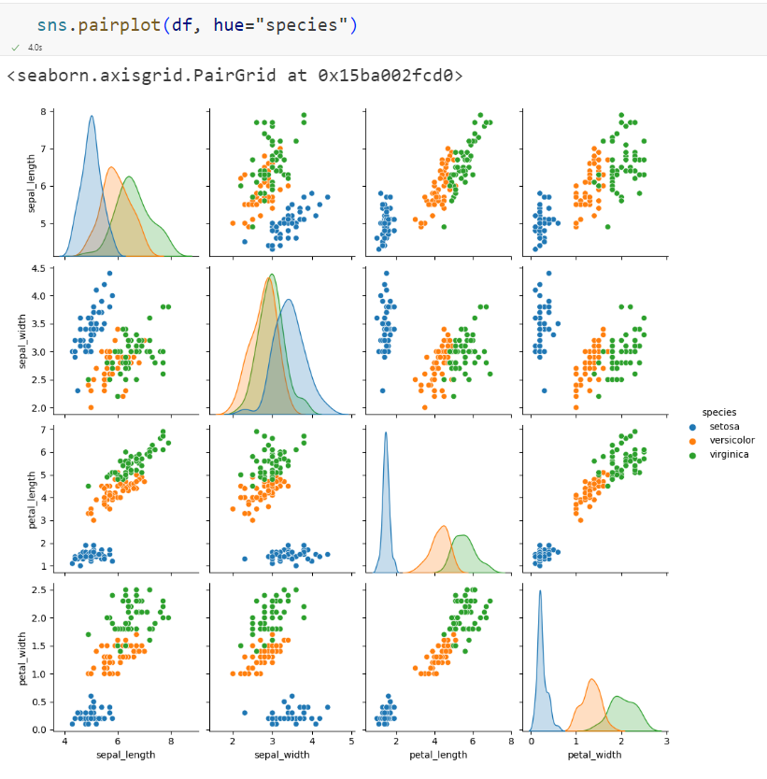
Color by category

Slide 40
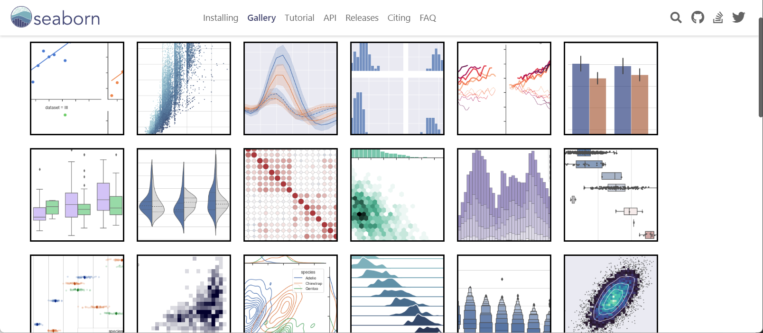
Find the style

Slide 41
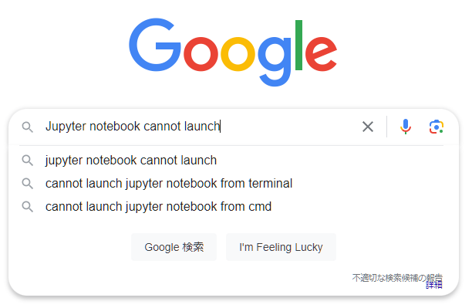
If you have problems…
Stack Exchange, GitHub issues…
Somebody must have experienced your problem

Slide 42
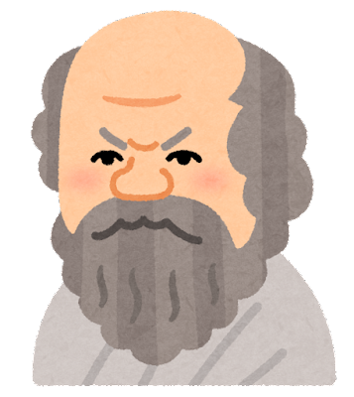
Keep asking (googling)!
聞くは一時の恥、聞かぬは一生の恥
Better to ask the way than go astray
I know nothing except the fact of my ignorance. - Socrates

